Slide 1



District
Grants

Slide 2

Where do the grants come from?
Contributions from 9700 & 9710 in the Rotary year 2018-2019 (Approx. US$192,000)
Half of which are returned to This District in 2021-2022 (Approx. US$96,000)
Half of which are available for District Grants
(Approx. US$48,000)
(20/21 year - US$58,000)
Notes:
District grants are single, annual block grants made to districts in amounts up to 50 percent of their District Designated Fund (DDF).
The district grant can fund multiple club and district projects, which may be local or international.
District grants allow local decision making, with minimal restrictions, for smaller-scale activities and projects.

Slide 3
The Conversion
20/21 Year US$58,501
Application July 20 @ 1.46 = AUD$85,407
Received Nov 20 @ 1.41 = AUD$82486
Applications Received totaled = AUD$99,422
21//22/ Year US$48,000
February 21 @ 1.30 = AUD$62,000
July 2021 @ ????? = AUD$????

Slide 4
What can they be used for?
Local or international activities
Proposed by either the District or Clubs
Smaller activities and projects (not Global Grants)
Local decision making with broader guidelines
District Grants are no longer “Matching Grants!!
Notes:
District grants are single, annual block grants made to districts in amounts up to 50 percent of their District Designated Fund (DDF).
The district grant can fund multiple club and district projects, which may be local or international.
District grants allow local decision making, with minimal restrictions, for smaller-scale activities and projects.

Slide 5
More information please !!
Notes:
District grants are single, annual block grants made to districts in amounts up to 50 percent of their District Designated Fund (DDF).
The district grant can fund multiple club and district projects, which may be local or international.
District grants allow local decision making, with minimal restrictions, for smaller-scale activities and projects.

Slide 6
Accessing forms on D9705 home page
Open home page
Scroll down til you see “Home page Download files”
Click on either District Grant guidelines
or District Grants application form
Notes:
District grants are single, annual block grants made to districts in amounts up to 50 percent of their District Designated Fund (DDF).
The district grant can fund multiple club and district projects, which may be local or international.
District grants allow local decision making, with minimal restrictions, for smaller-scale activities and projects.

Slide 7
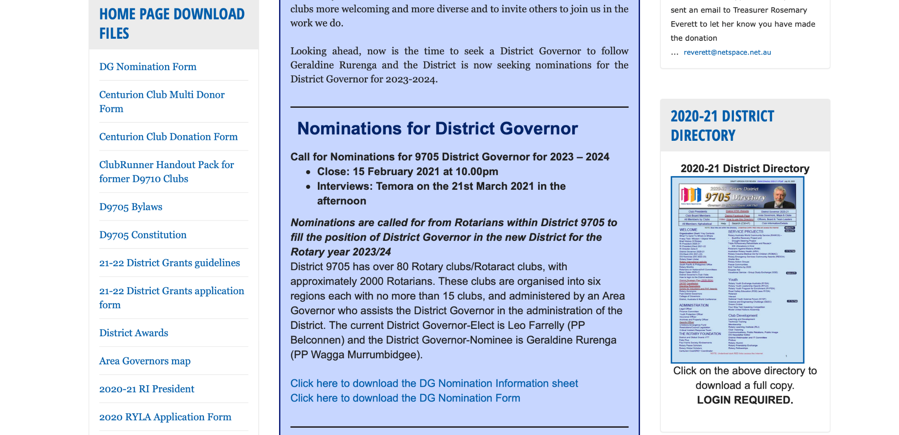
Notes:
District grants are single, annual block grants made to districts in amounts up to 50 percent of their District Designated Fund (DDF).
The district grant can fund multiple club and district projects, which may be local or international.
District grants allow local decision making, with minimal restrictions, for smaller-scale activities and projects.

Slide 8
Now for some examples of
Grants to Clubs
in the current Rotary Year
and how they were used .
Notes:
Review district-specific information.
ASK: What planning will your club need to do before receiving district grant funds?

Slide 9
EXAMPLES: Grants approved in this current year
Aurora Gungahlin $90,800
District Grant $5,000
Power wheelchairs for those with a disability to participate in wheelchair soccer
Notes:
Let’s look at some examples of local and international district grant projects.

Slide 10
Berry– $7,500
District Grant $5,500
Fresh water bores in Uganda
Notes:
Let’s look at some examples of local and international district grant projects.

Slide 11
Blayney - $6,600
District Grant $2,000
Provision of food hampers during COVID
Notes:
Let’s look at some examples of local and international district grant projects.

Slide 12
E Club Serving Humanity: $10,800
District Grant $5,000
Lotus Program for ESL in Sri Lanka
Notes:
Let’s look at some examples of local and international district grant projects.

Slide 13
Parkes- $3,000
District Grant $1,500
Renovate the Peace Park
Notes:
Let’s look at some examples of local and international district grant projects.

Slide 14
Woden Daybreak : $6,576
District Grant $ $3,288
Teacher Training in Namibia
Notes:
Let’s look at some examples of local and international district grant projects.

Slide 15
District Grant Guidelines:
It is most important that you read
and follow the Guidelines!!
As it states – it provides the
Guidelines for Grants – what you can
and can’t use funds for!

Slide 16
Page 5 of the Guidelines –
“Restrictions” - Very Important
Part a) should be obvious
Part b) should be read and understood completely.
Notes:
Let’s look at some examples of local and international district grant projects.

Slide 17
Important dates for projects in the coming year -
Submit your signed MOU and your project application before 31st May 2021
Final reports from Clubs due 31st May 2022
Remember……
No final report….. No reimbursement and no new projects for your club till finalised
Notes:
Review district-specific information.
ASK: What planning will your club need to do before receiving district grant funds?

Slide 18
District 9705 Grants Chair
Phil Armstrong
philaarmstrong@gmail.com
0418 259 963
District Rotary Foundation Chair
John McKenzie

