Slide 1


KEY PARTNERS – DO NO DELETE THIS TEXT, USED FOR HYPERLINKS
RI Theme 2021 - 22

Slide 2
District Insurance
DIO Chris Bennett

Slide 3


Slide 4
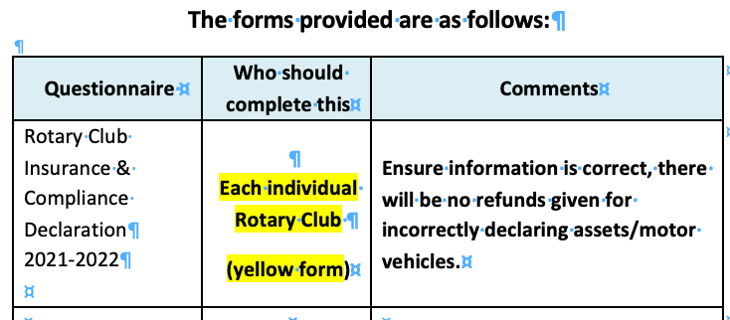
Insurance Renewal Pack

Slide 5
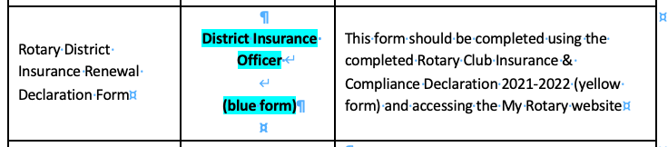

Slide 6
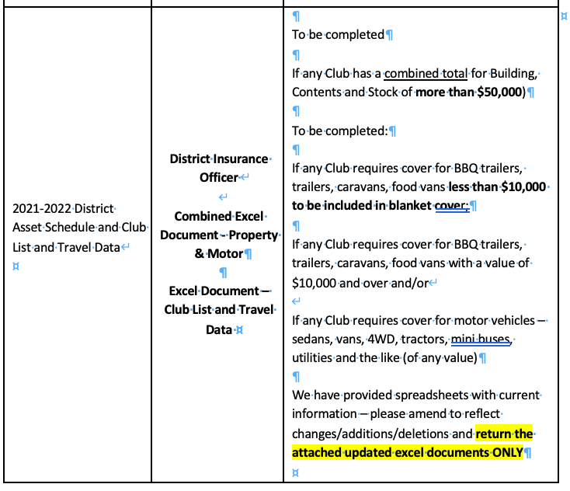

Slide 7
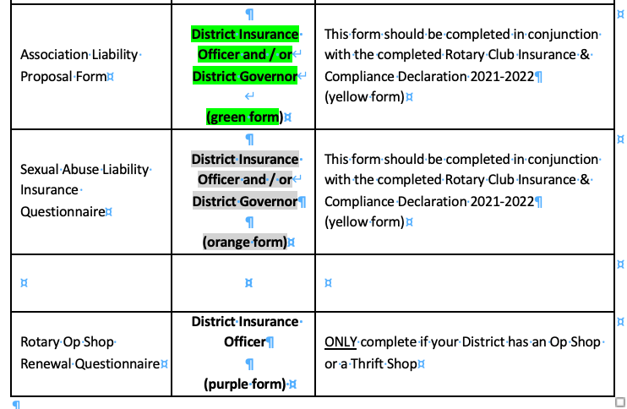

Slide 8
Compliance
Declaration

Slide 9
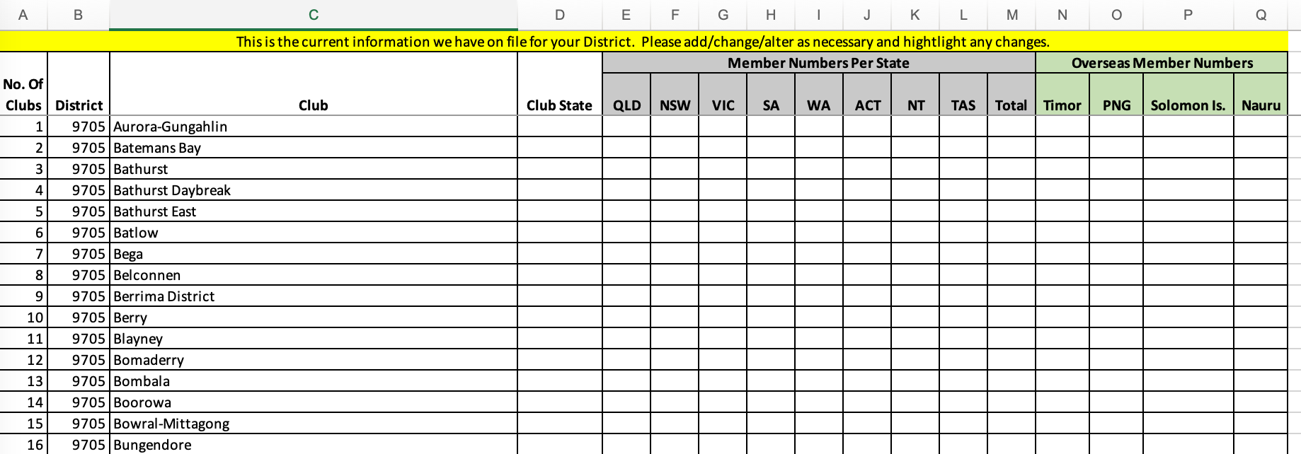
Club List

Slide 10
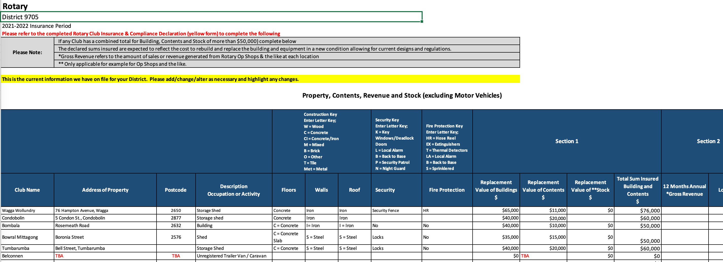
District Asset Schedule

Slide 11
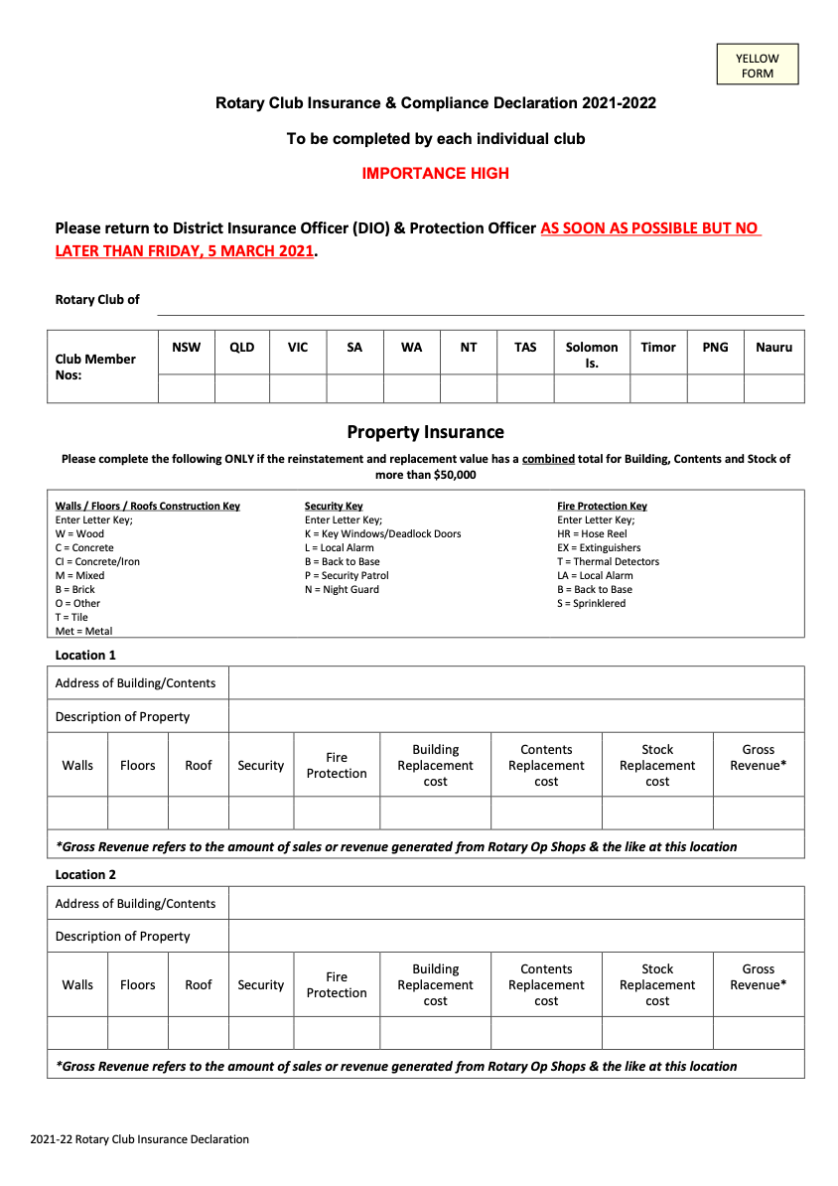
Compliance Declaration
(yellow form)

Slide 12
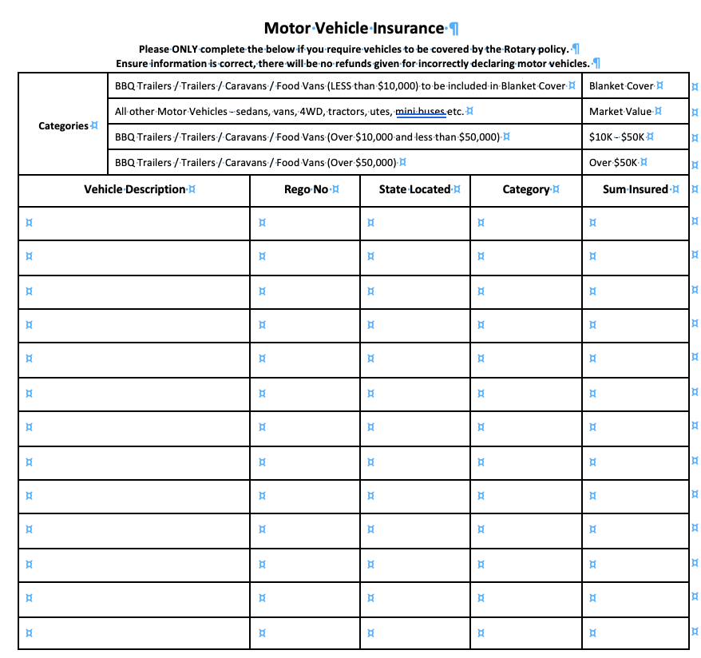
Motor Vehicles

Slide 13
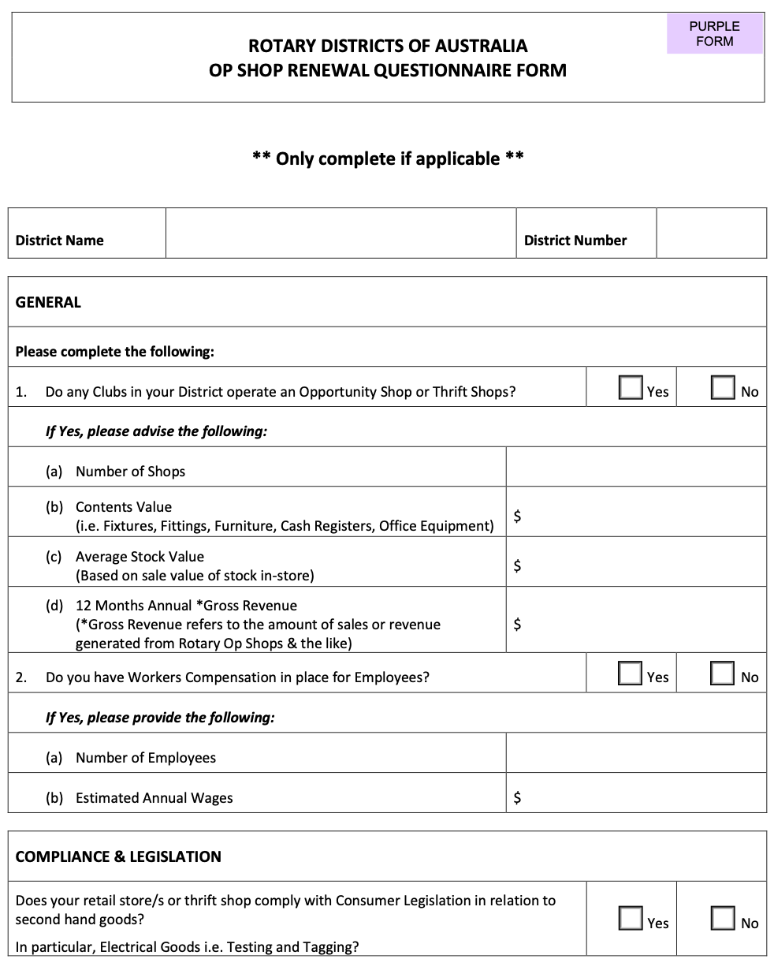
OP Shop Renewal

Slide 14
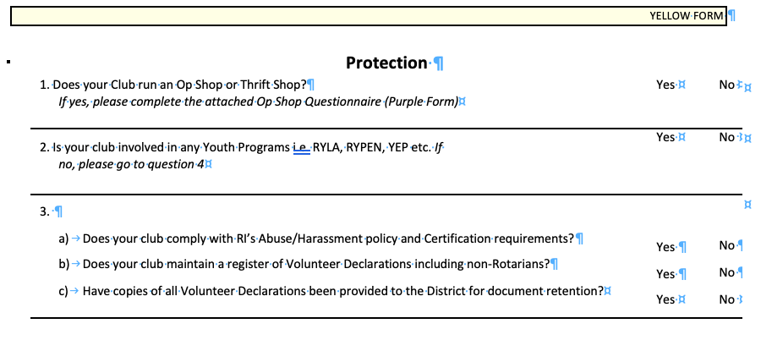
OP Shops

Slide 15
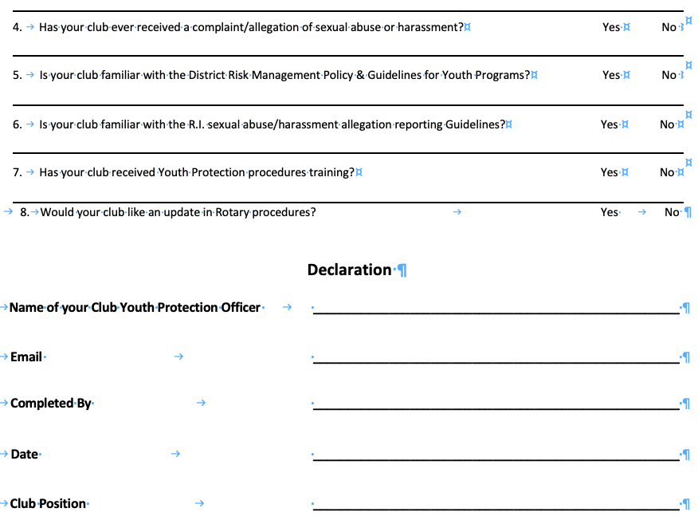

Slide 16
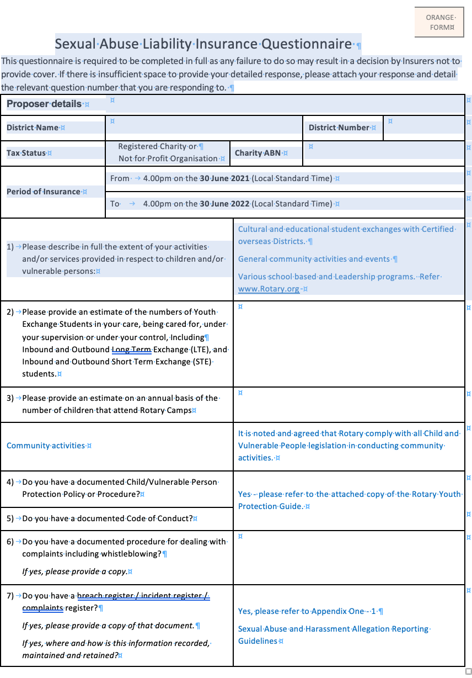
Sexual Abuse
Liability Questionaire

Slide 17
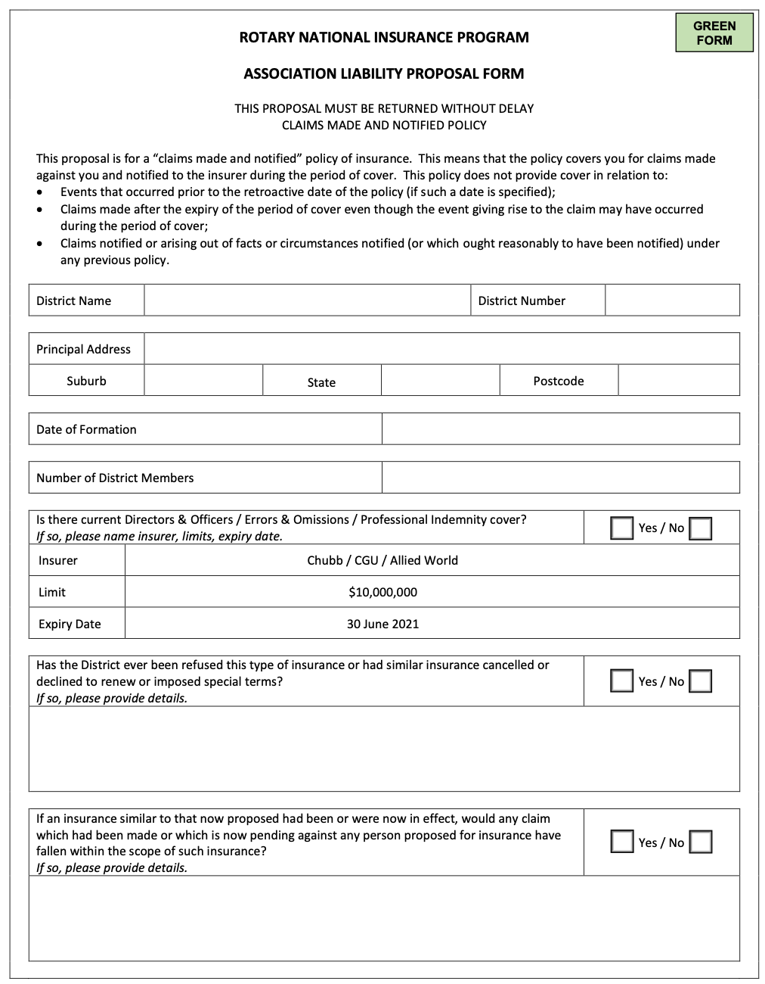
Liability Proposal Form

Slide 18
