Slide 1
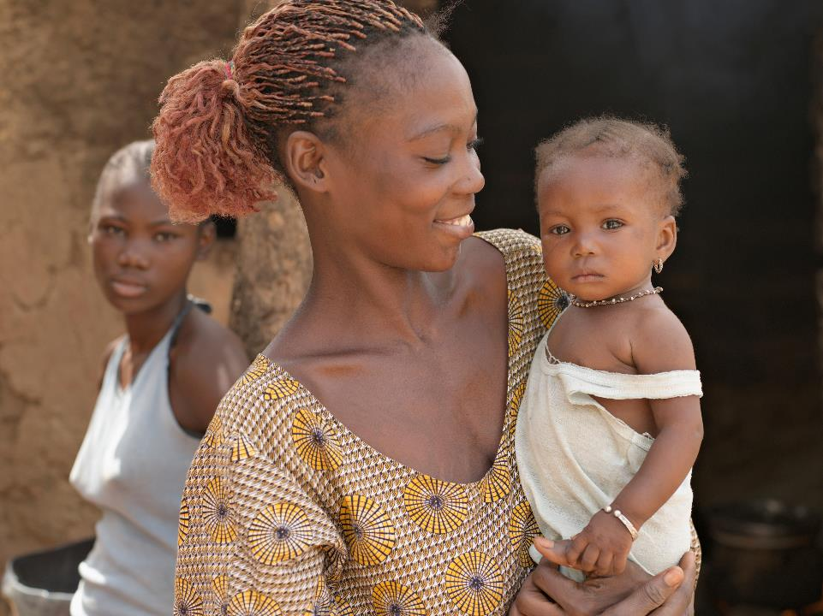


Slide 2
The Priorities of The Rotary Foundation
End Polio Now: Countdown to History
Increase sustainability of our service efforts within the seven areas of focus through the use of both district and global grants
Encourage the full use of District Designated Funds
Encourage gifts and commitments that establish personal legacies within Rotary’s Endowment

Slide 4
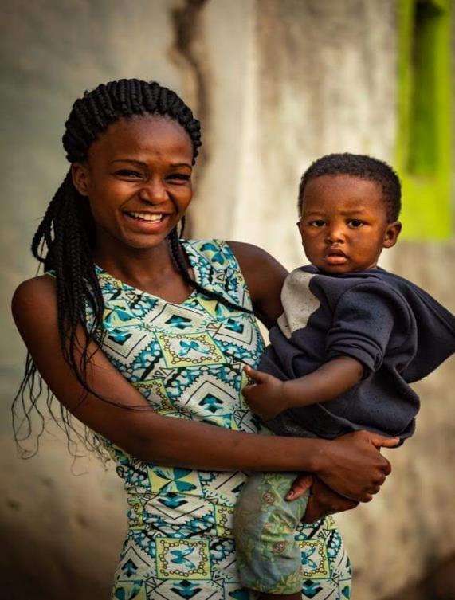
Programs of The Rotary Foundation
Polio
District Grants
Global Grants
Vocational Training Teams
Area of Focus Scholarships
Rotary Peace Scholarship

Slide 5
Charities in Australia
receive a total of
$10.5 billion
in donations and bequests
per year
(excluding government funding & investment returns)

Slide 6







on average, Australians:
  support 3 charities
  with average donation of $106 per charity (NAB, 2016).
most Rotarians support charities too:
  but just 27% contribute to The Rotary Foundation
  and TRF is OUR charity!!
Rotary has one official charity
Personal Giving is all about getting behind our charity!

Slide 7
EVERY ROTARIAN EVERY YEAR - CENTURION CLUB
The Centurion Program
Personal Engagement with The Rotary Foundation
$100 per year
Annual Fund ONLY

Slide 8

Suggested Club Business Plan
One Paul Harris Society member per Club
100% of all members to be Centurion
Centurion
$100
Consider 15% of Club Fund Raising to TRF
Apply for a District Grant
Commit ^{US}$1500 to End Polio Now
TRF to be part of every Rotarian’s Charity Giving

Slide 9

ROTARY’S ROLE IN THE ERADICATION OF POLIO
Fundraising
Advocacy
Raising
Awareness
Rotarian
Engagement
Notes:
CAROL

Slide 10
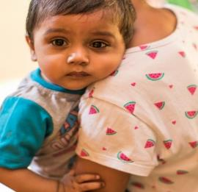
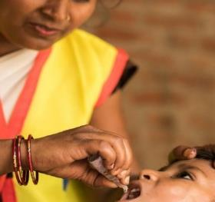
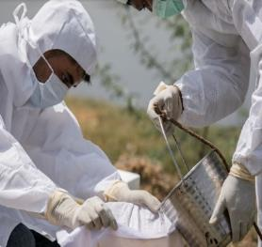
This is how we are doing it
Immunizing up to 450 MILLION
CHILDREN
in up to 40 countries
every year
Funding over
150,000
POLIO- WORKERS
in up to 70 countries annually
Continuing
DISEASE
SURVEILLANCE ACTIVITIES
in more than 70 countries
Notes:
Over the next several of years, hundreds of millions of children will continue to be immunized against polio to protect the gains we have made in up to 40 countries which requires over 150,000 polio workers all supported by the Global Polio Eradication Initiative.
And methods to detect the disease are already intensifying by testing samples from people AND sewage in the endemic and in an increasing number of high risk countries to be absolutely sure there is no poliovirus circulating. For example, Pakistan has the largest environmental surveillance system that tests sewage from 59 sites in 31 cities.
Pictured: Images in Ghaziabad, Uttar Pradesh, India at the Urban Primary Health Centre and lab technicians from the National Centre for Disease Control Take water samples to test for poliovirus at Bhalswa Lake in Delhi, India. June 2019.

Slide 11
Polio cases 2013-2019 (as of 31 December)
176
Notes:
This slide illustrates the dramatic decline in polio cases over the past several years and indicates the progress we continue to make.
In 2014, we celebrated one of the world’s greatest achievements in global health: India being certified as polio-free. India was once considered the hardest place on earth to stop polio because of its dense population and challenges with sanitation. India’s success proves polio can be stopped in even the most challenging conditions.
You can see the slight uptick in polio cases in 2018 and 2019. However, now is not the time to panic but to redouble our efforts. Note that the for past four years, we have been under 100 polio cases. And the virus is circulating in limited areas of Pakistan and Afghanistan. The remaining challenges to reaching all children with the polio vaccine will be highlighted later in this presentation.

Slide 12
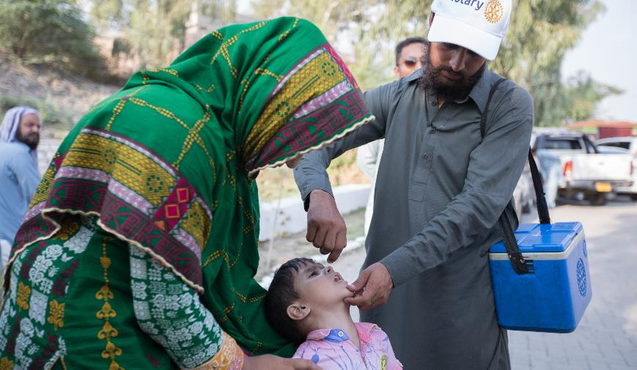
Enhance your Polio Donation
The Bill and Melinda Gates Foundation continues to provide a two for one donation for every dollar donated to Polio

Slide 13
Rotary Grants…..
Spending
The Rotary Foundation
money on
local and international projects
…to do good in the world®

Slide 14
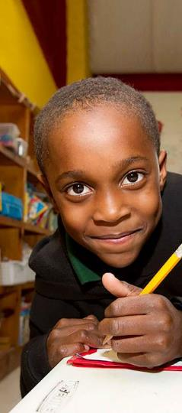
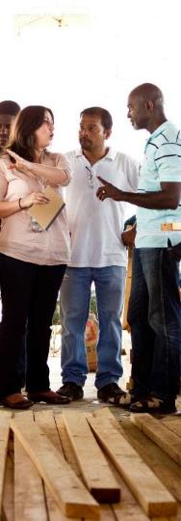
Rotary Grants
  District grants
  Global grants
Notes:
The Rotary Foundation offers grants that support a wide variety of projects, scholarships, and training that Rotarians are doing around the world. There are two types of grants available: district grants and global grants.

Slide 15
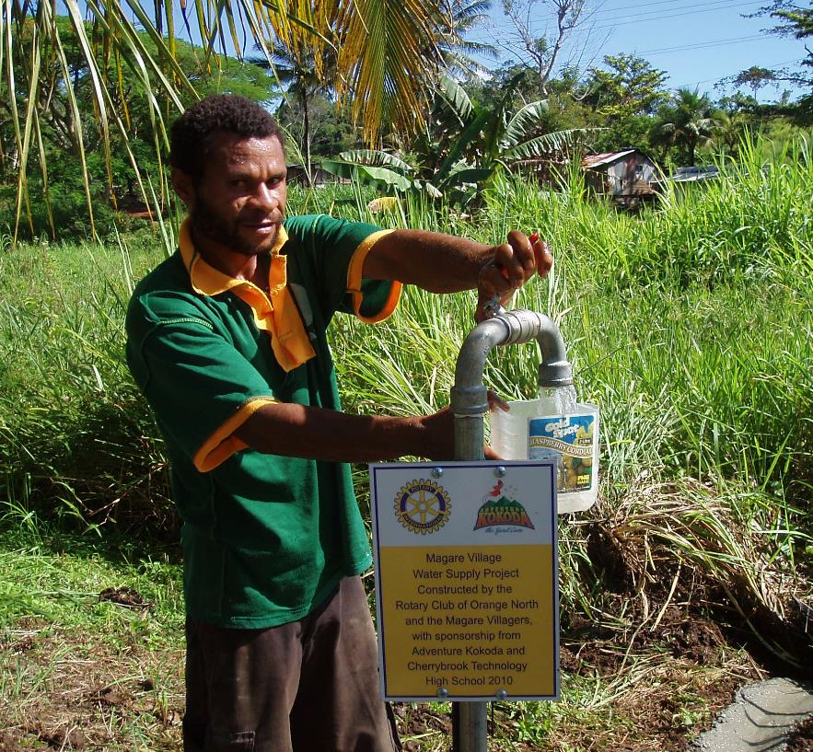
District Grants
  Small-scale, short-term
  Local or international activities
  Aligned with the Foundation’s mission
  Single grant awarded annually
  Club submission required
Notes:
District grants fund small-scale, short-term activities that address needs in your community and communities abroad. Each district chooses which activities it will fund with these grants. You can use district grants to fund a variety of district and club projects and activities.
You have a lot of freedom to customize your service projects. There aren’t many restrictions, as long as your district grant supports the mission of The Rotary Foundation, which is to enable Rotarians to advance world understanding, goodwill, and peace through the improvement of health, the support of education, and the alleviation of poverty. Districts must be qualified before they can administer district grants.
Districts may use up to 50 percent of their District Designated Fund to receive one district grant annually. This percentage is calculated based on the amount of DDF generated from a district’s Annual Fund giving three years prior, including Endowment Fund earnings. You aren’t required to request the full amount available.
Districts receive this funding as a lump sum and then distribute it to their clubs.

Slide 16


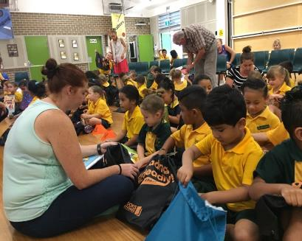
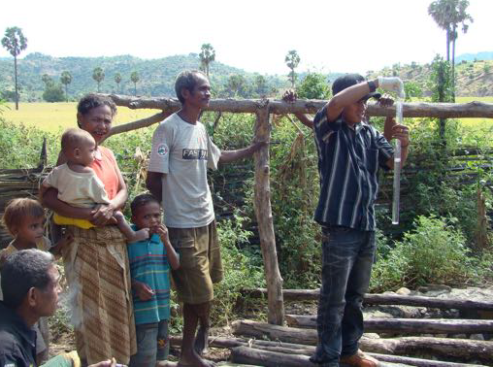
DISTRICT GRANT Examples
Rotary Club of Mosman has supported “Books in Homes” in providing books to infants and grade 1 pupils at a school in Mt Druitt
Clean water has been provided to the town of Pune in East Timor by Rotary Club of Epping. 43 Bio-sand filters have been installed in homes
Notes:
Rotarians in District 4420 (part of Sao Paulo, Brazil) used district grant funds to begin Project READ (Reading and Education Center) to provide reading rooms for children in poor communities. The project equips each center with books and toys that encourage reading among children ages 5-12. A local monitor supervises each reading room and tutors students.

Slide 17

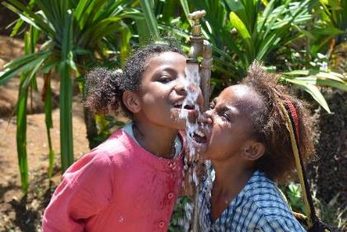
GG 1527246 Example
Rotary Club of Bribie Island, D9600
Cervical Cancer Vaccination Program in PNG
28,000 girls
Aged 9 -13
38 Schools

Slide 18

Funding : GG 1527246 Example
Sponsor Club: $1,000 (0.3%)
Collaborating Clubs: $100,000 (30.5%)
Other Districts DDF: $98,000 (29.9%)
World Fund match: $129,500 (39.3%)
Total Project: $329,000

Slide 19
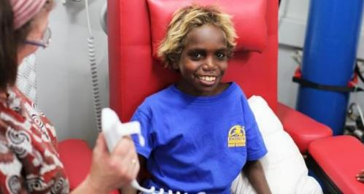

local (A/NZ) projects too:
Pukatja, South Australia
Remote indigenous
community
  kidney disease 15x national average
  project created by Waikerie Club
  A$200K dialysis facility
funding support from
  Clubs and Districts in Aus & USA
  A$70K Global Grant.
fighting disease
Notes:
But not all Global Grants are for overseas projects.
Here’s one put together by a South Australian club
for a project in the north west of the state..

Slide 20
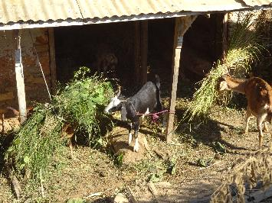
Local D9705 project :
Nepal
Global Grants
empowering women socially and
economically through sustainable agriculture (goat farming)
  To empower the women of Rabi & Devitar Village.
  2. Helps women to generate more income to invest in family health & education.
  3. To create confident & dignity in the lives of women
funding support from
  6 Clubs in D9705, one club in Nepal, 2 OS Districts
  $15K Global Grant.
Economic development
Notes:
But not all Global Grants are for overseas projects.
Here’s one put together by a South Australian club
for a project in the north west of the state..

Slide 21






Key to Global Grant Success
Community needs assessment
Rotarian engagement
International partner
Area of focus fit
Sustainability

Slide 22

The positive cycle of community projects
Identify community need
Develop project with Partner orgs
Fundraise specifically for project
Deliver and measure project
Publicise and grow Rotary reputation

Slide 23
…to do good in the world
Growing our reputation through The Rotary Foundation
Rotary Club raises Money
Rotary Club contributes to TRF
Rotary club applies for a Grant
The Grant provides funding for local or international projects
Reputation of the Rotary Club grows

Slide 24
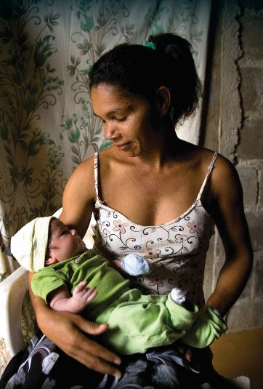

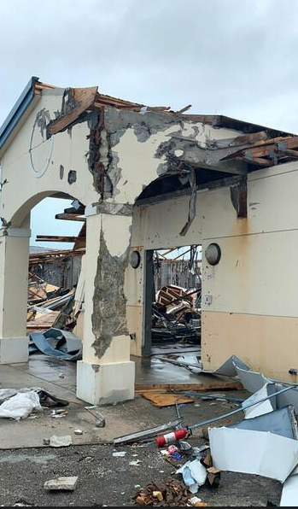
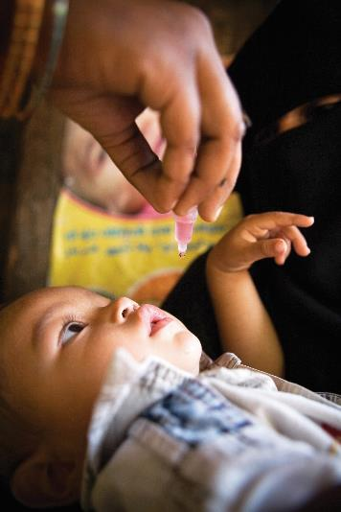
Annual Fund
Funding Grants and Scholarships
Endowment Fund
Funding the Future
Funding RPF Program
Disaster Response
Fund
Funding Immediately available up ^{US}$25k per grant
Polio Fund
Funding End Polio Now

Slide 25
