Slide 1
DISTRICT Goals 2021-22

Slide 2
Our Journey Together in D9705
We are One District with many approaches to community service
To maximise our effectiveness we want connected and harmonized Club/ Area/ District development plans
A Rotaractor will be included on all District Teams and Committees to ensure a next generations approach to all we do.
All our projects and community work will have success measures so we can celebrate the benefits realized for our communities through Rotary’s positive activity.
Innovate and Grow – COVID19 has given us a great opportunity to rethink Rotary in our communities
I see these District Goals more as District Development objectives. Each Area and each Club is expected to develop their own plan with progress overseen by the Area Governor and the Operations Team.

Slide 3
Rotary’s Vision Statement
Together we see a world where people unite to take action to create lasting change across the globe, in our communities and in ourselves.

Slide 4
Rotary’s Strategic Priorities and Objectives
EXPAND OUR REACH
Enhance participant engagement
INCREASE OUR IMPACT
Increase OUR ABILITY TO ADAPT

Slide 5
EXPANDING OUR REACH
Develop new-style Clubs – Rotary and Rotaract – such as cause-based, e-Clubs, corporate clubs, satellite and passport clubs. The evidence from RI is that these approaches bring growth. Every community in our District could support a new-style Club in parallel to existing Clubs.
Enhance participation in Rotary Action Groups – vary the Rotary experience for members.
Explore Rotary Community Corps – tap into the community. Expand you community service reach.
Link with like-minded organisations – Service clubs, eco/ enviro groups, Youth organisations, Chambers of Commerce, etc

Slide 6
EXPANDING OUR REACH
SUGGESTED MEASURES
Net increase in membership – Each One Bring One.
50/50 male/female gender mix.
Net increase in the number of members in a Rotary Fellowships
Net increase in the number of service hours devoted to hands-on local projects – target a 15% increase as a minimum

Slide 7
Through a revitalised Operations Team the District will provide better support to Clubs and be more responsive to their needs.
The Club Development team, especially the Membership, Communications and Public Relations/Public Image teams will be central to this effort.
In each of our six Areas, Rotary Action Days will showcase Rotary and its community work.
Develop measures to gauge your value to your Community.
Better training for members in all things Rotary. Actively promote individual engagement with Rotary’s learning and development resources.
Enhance Engagement

Slide 8
Enhance Engagement
Suggested measures
Net increase the numbers of members engaged in Leadership development training through the Learning Centre in My Rotary.
Succession planning - Change your Club practices to always have a President Elect and a President Elect Nominee.
Every Club participate in the Rotary Action Days organized in your Area.
Commit to 100% Club leadership attendance at the District Development Assembly.
Commit to 80% of Club members attending the District Conference.
Have 50% of members engaged in a Rotary Fellowship or Rotary Action Group.

Slide 9
Increase the Impact of our Service
Rekindle support for the Foundation through personal donations. It is our charity and donations to The Rotary Foundation are tax-deductible.
Commit a percentage of fundraising, say 10%, to the Foundation.
Each member pledge to become an EREY - $100 per year - $2 a week
D9705 will create a District International Service Chair to assist Clubs which want to be part of an international project.

Slide 10
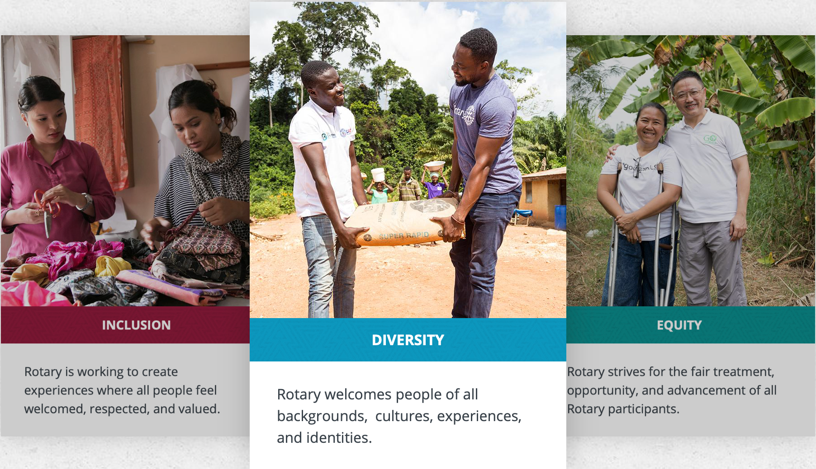
Diversity
Equity
Inclusion
Increase our Ability to Adapt

Slide 11
Talk about diversity with your club members and create a member diversity and inclusion action plan using the Diversifying Your Club assessment.
Diversity is a fact. Inclusion is an act — it takes effort and practice. But over time, it should lead you to a more equitable place, with equal opportunity for all people.
Lead with inclusion, because if you create an inclusive environment, then diversity will come. Inclusion is about the way people behave toward one another. To be inclusive is to be open to difference. Start with your Club – does anyone feel excluded?
Increase our Ability to Adapt
Suggested
measures
Do we reflect the communities we serve?

Slide 12
Innovate and Grow Any questions?
What does this mean for your Club?
Starting this weekend we will be accelerating the devolution of the DG’s role to the Area Governors
As each Area is different geographically and demographically Area Governors have been tasked with developing Area Development Plans and they will be working with you on your Club Plans.
The result will be connected and harmonized development plans for the District while allowing maximum flexibility for Clubs to put their own stamp on local community service.

