Slide 1
Increase our Ability to Adapt
Club Development Seminar
Andrew Giumelli & Emma Bell

Slide 2
Welcome Rotarians!
Goals of the session:
  Harnessing our WHY
  Club Reflection
  Fill the Gaps – Action Plan

Slide 3
Icebreaker
Who are you and what club are you from?
What brand of toothpaste do you use and why?
Or
What was your first job? And your most recent job?
Or
If you were an animal what would you be and why?

Slide 4
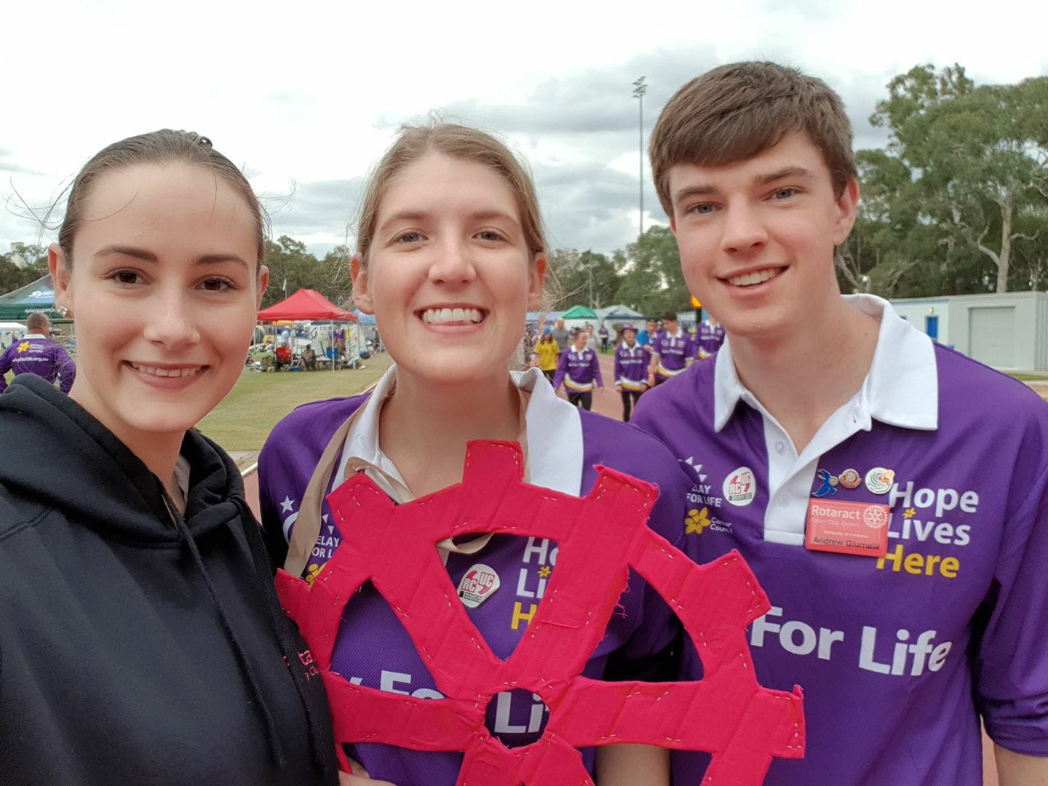
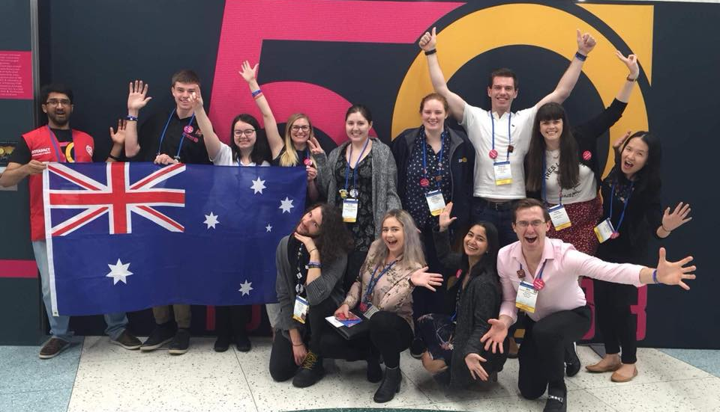
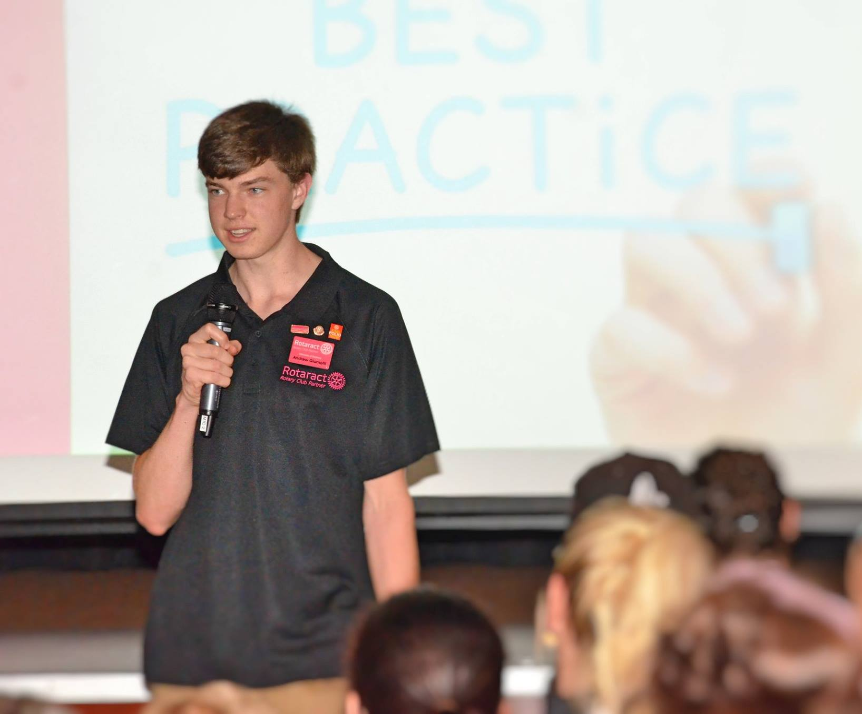
Andrew Giumelli
Joined Rotaract Club of UC in 2017
Past Vice President and Past President of RCUC
Studying Network and Software Engineering @ UC
Participated in RYLA in 2018
RYLA Leader in 2019 and joined the RYLA Committee for 2020 and 2021
District Rotaract Representative 9705 2020-21
Rotarian – RC of Hall
Attended RI Convention in Toronto 2018
IT Director for Rotaract Australia 2018-21

Slide 5
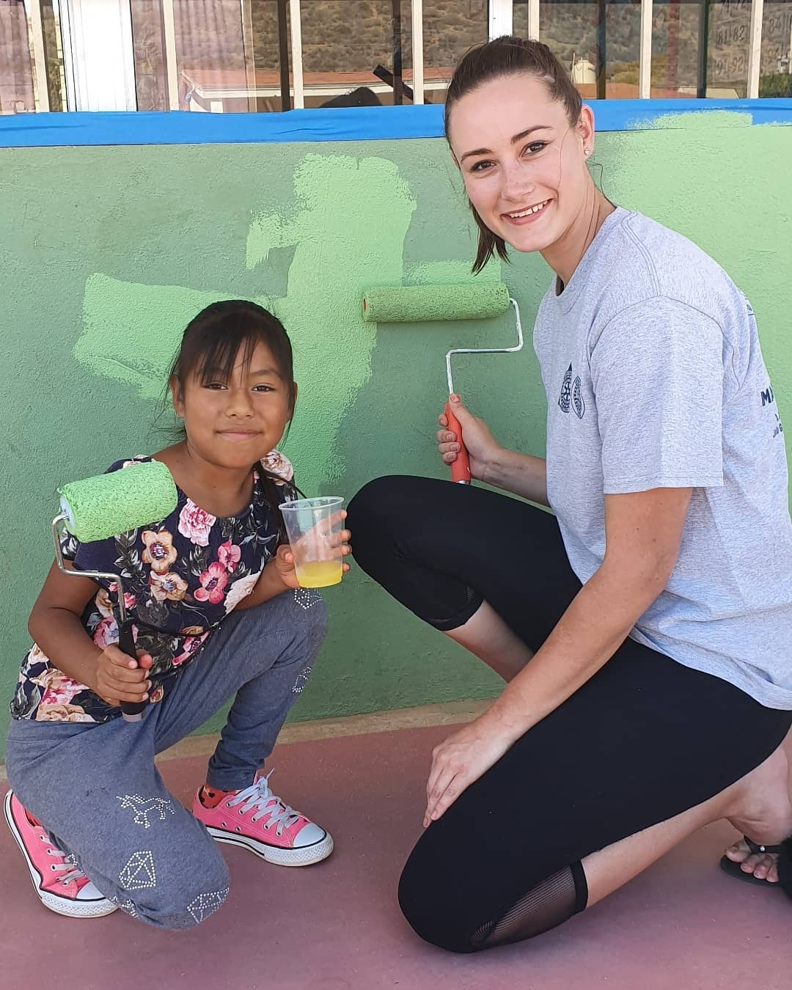
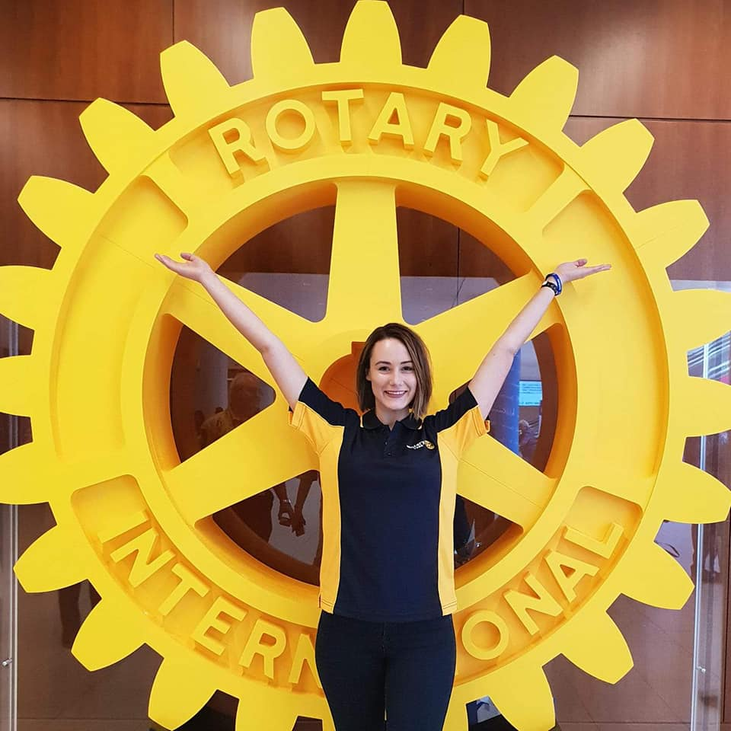
Emma Bell
Rotary Youth Exchange Student – USA 2011
Charter President Rotary Club of University of Canberra 2013
Graduated with International Studies & Communications Degrees
RYLArian – D9710 & RYLA Oceania
Obsessed with International Conventions – Sydney, Sao Paulo, Seoul, Atlanta, Toronto
Service Project in Mexico with Rotarians and Rotaractors from San Diego
Rotarian – RC of Hall
Consultant – Downer Defence
I <3 New York
District Rotaract Representative 9710 2017-18

Slide 6
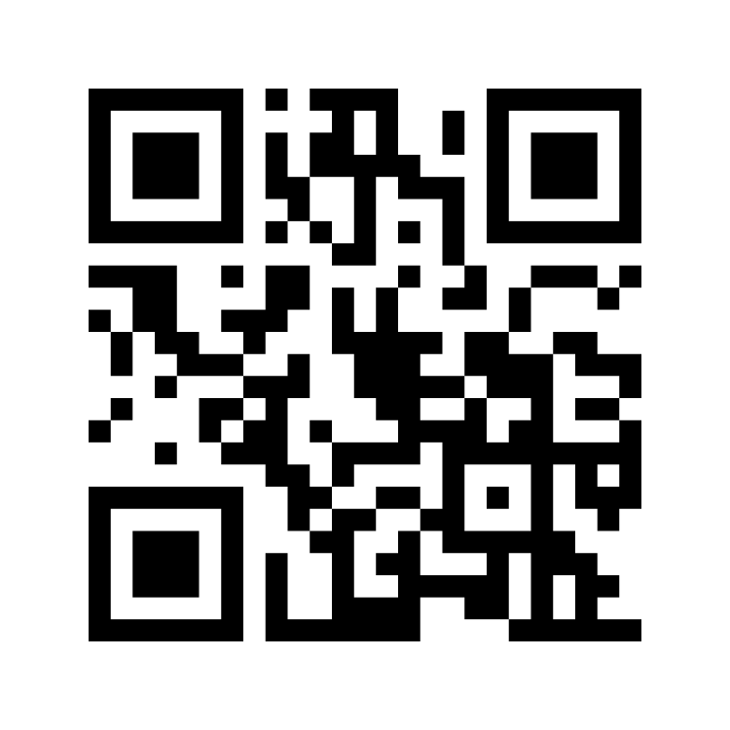

WHY ROTARY?
Go to www.menti.com
and use the code
5598 0820

Slide 7
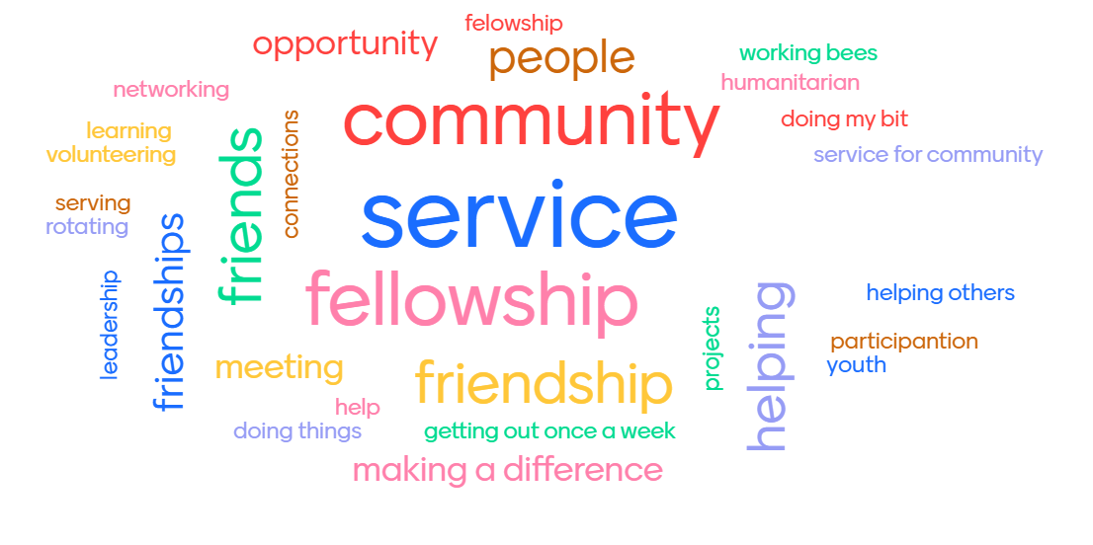
YOUNG

Slide 8
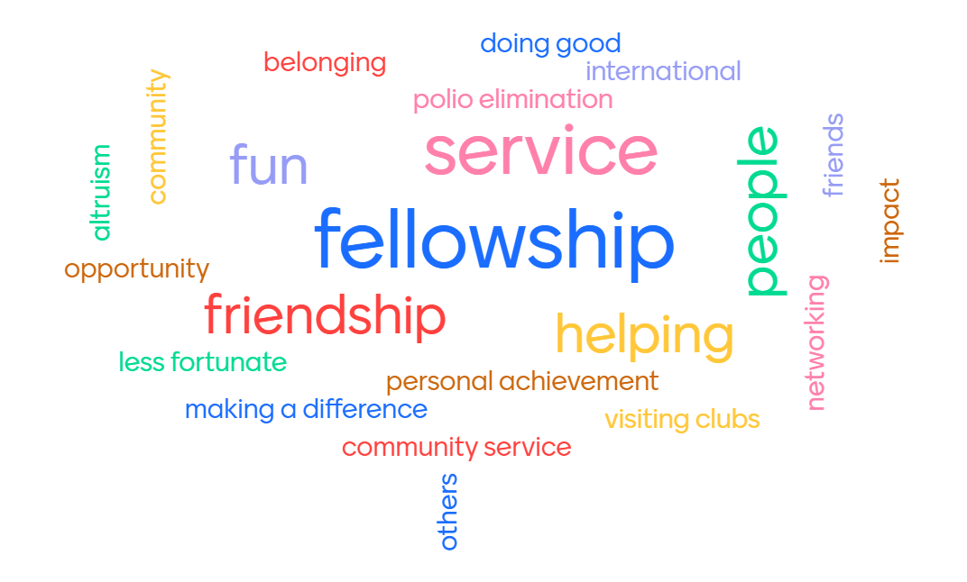
BROULEE

Slide 9
Club Reflection
What’s something that your club has started doing in the past 1 – 5 years that is
new, exciting and interesting?
How diverse and inclusive is your club? Examples.
What value does your club provide in your life, your community, and for potential members?

Slide 10
Club Reflection Shareback
What was one thing you learned from another Rotarian that you could take back to your club?

Slide 11

A D A P T
become adjusted to new conditions.
"a large organization can be slow to adapt to change"

Slide 12


V A L U E
People will invest in things they see value in.

Slide 13
V A L U E
Proposition
We…
“Reduce/Remove” or “Increase/Create”
(Value that members want)
By…
(What you do)
“Last year” or “This year”
(Case study proving results)
“In fact” or “Plus”
(What makes you unique)

Slide 14
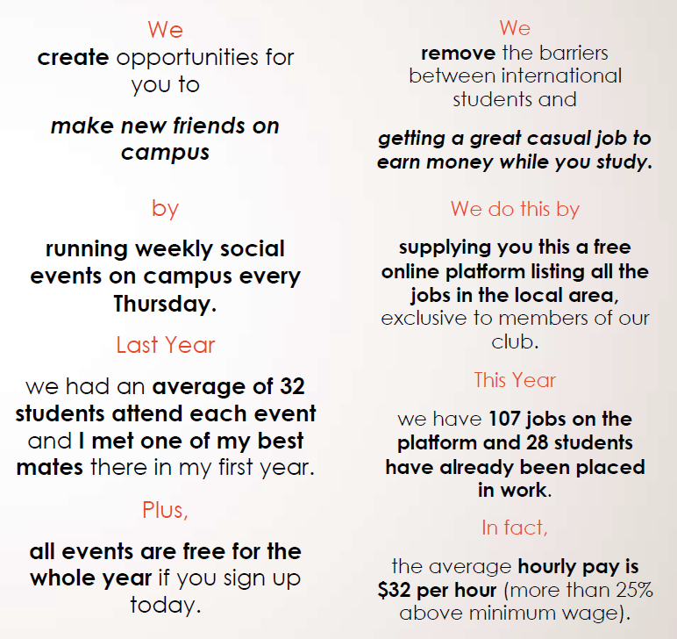
Student Group Examples

Slide 15
Engaging new members
Meetings
  Provide value to members
Onboarding experience
  Map the process for new members
Dynamic Digital Presence
  Consistent Brand
  Budget and Prioritise
  Tell your story
Invite, invite, invite
  To social media
  To upcoming events
  To projects
  To guest speakers

Slide 16
Let’s Fill the Gaps
What value can you add to your club and fellow Rotarians?
What skills and experiences do your members have that can be harnessed?
Who can you reintroduce to your club? Youth Exchange, RYLA, etc.
What projects and events do you have coming up that you could invite someone to?
What could you strengthen within your club by finding someone from the community to fill the gap e.g., marketing and advertising student, social media person, etc.
How often does your club have social meetings?
Are you active on social media?
Do you have buddy/mentoring systems?
When was the last time you visited another Rotary or Rotaract Club?
LGBT Fellowship D&I Tool.

Slide 17
Action Plan
What are you going to take back to you club?
How are you going to empower members to support you with this idea?
How are you going to measure success?
What timeframe are you going to work to and is this realistic?

