Slide 1
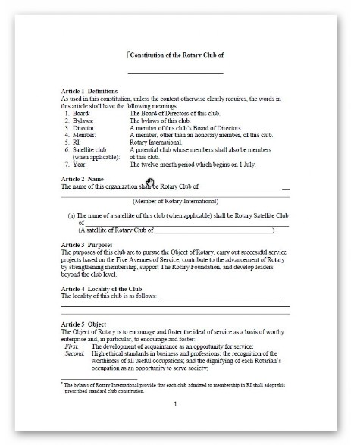
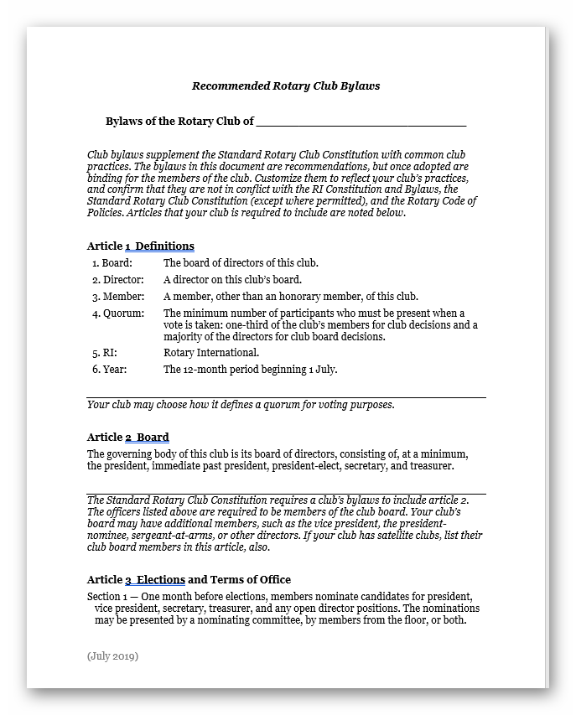

Club Governance
Incorporation
Constitution
By Laws

Slide 2

Governance
Question: Are clubs totally Autonomous?
Answer is NO
Because each club is chartered
RI Code of Policies,
RI Constitution and Bylaws
District Constitution, By Laws and Policies
Notes:
Are clubs fully autonomous – NO
Because each club is chartered they must abide by RI Code of Policies, RI Constitution and Bylaws and District Constitution, By Laws and Policies (Rider unless state law over rides it)

Slide 3
Governance
Constitutional matters
Adopt recommended Constitution
New South Wales
Fair Trading – see model rules and other requirements
Add to Constitution
Approval by RI
ACT
Access Canberra
Simpler requirements than NSW
Add to Constitution
Approval by RI

Slide 4
Governance
Constitutional matters
Article 7 Exceptions to Provisions on Meetings and Attendance
Cover in your By-Laws
Term of President. The president shall be elected not
more than two (2) years but not less than
eighteen (18) months prior to the day of taking office

