Slide 1
Be a Vibrant Club

Slide 2
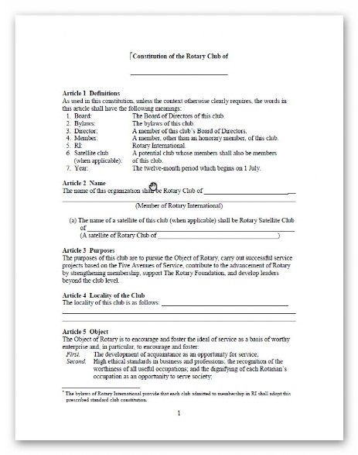
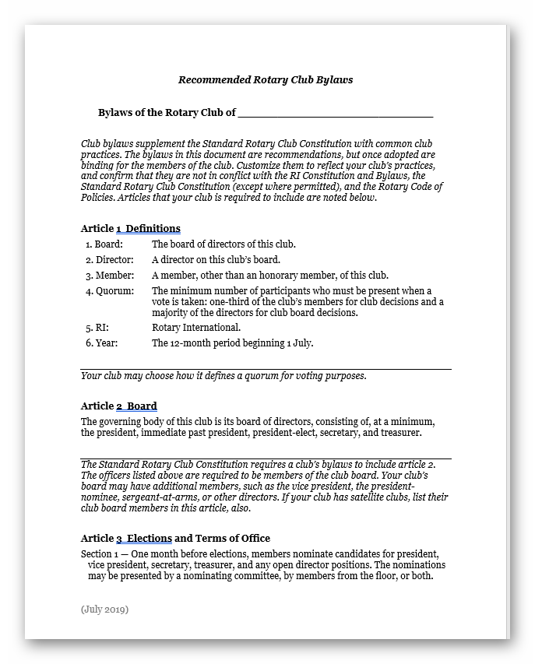
Governance
Incorporation
Constitution
By Laws
Notes:
You must have
Incorporation
Constitution – RI Recommended Club Constitution – updated after every COL every 3 years.
By Laws – use RI recommended as a starting template

Slide 3
BE A VIBRANT CLUB
START YOUR CLUB ON A PATH TO VIBRANCY
Decide what you’d like your club to be like in three to five years.
Plan an annual visioning session,
Rotary Club Health Check
Use the Strategic Planning Guide to set long-term goals.
Notes:
Decide what you’d like your club to be like in three to five years.
• Plan an annual visioning session, and use the Rotary Club Health Check to identify your club’s strengths and areas that need improvement.
• Use the Strategic Planning Guide to set long-term goals.

Slide 4
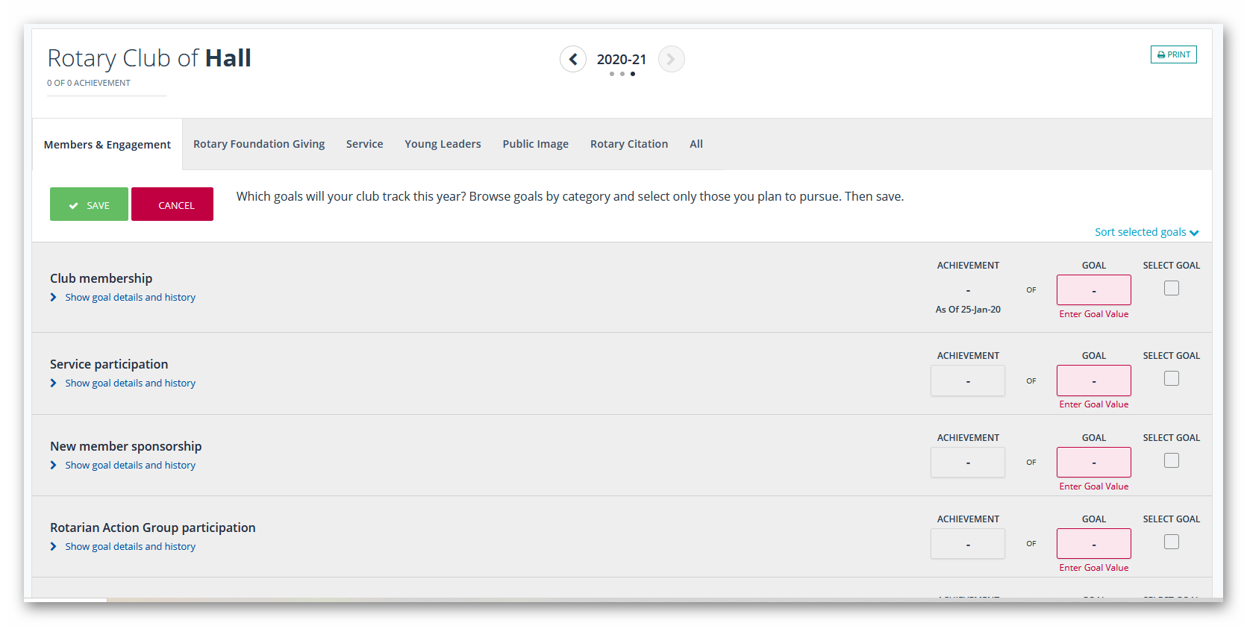
BE A VIBRANT CLUB
YOUR ANNUAL GOALS,
Enter them into Rotary Club Central.
Focus on something your club is good at, and make it something your club is great at.
Update committees once a month on your goal progress.
Notes:
Decide on your annual goals,
enter them into Rotary Club Central.
Focus on something your club is good at, and make it something your club is great at.
Update committees once a month on your goal progress

Slide 5
BE A VIBRANT CLUB
CLUB MEETINGS
Keep members engaged and informed.
Conduct the Member Satisfaction Survey
Vary your meeting format
Notes:
Keep members engaged and informed.
Conduct the Member Satisfaction Survey to find out what your members like and don’t like about your club, and create a plan for implementing changes.
Vary your meeting format to include a mix of traditional and online meetings, service projects, and social gatherings.

Slide 6
BE A VIBRANT CLUB
COMMUNICATE OPENLY IN YOUR CLUB.
Share information
Rotary Brand Centre
Notes:
Share information at club meetings, on your club website, and through social media, and check regularly to see how members are feeling.
• Use the templates and resources in the Rotary Brand Centre to create your club brochures and newsletters

Slide 7
BE A VIBRANT CLUB
FUTURE ROLES
Smooth leadership transitions.
Ensure continuity
Conduct on-the-job training for incoming club officers
Notes:
Prepare Members for Future roles to smooth leadership transitions.
• Ensure continuity by making appointments for multiple years, having a current, incoming, and past chair on each committee.
• Conduct on-the-job training for incoming club officers, and have job descriptions for each officer.

Slide 8
BE A VIBRANT CLUB
BY LAWS
Adapt your club’s bylaws
Involve your members
Recommended Rotary Club Bylaws
Notes:
Adapt your club’s bylaws to reflect the way the club works.
• Involve your members when you review your club’s bylaws every year.
• Edit the Recommended Rotary Club Bylaws template to reflect new practices and procedures

Slide 9
Download
Notes:
A

